Slide 1
Predicting Customer Interest in Vehicle Insurance

Slide 2
Project Overview
ICEA Lion Group is expanding its offerings beyond life insurance policies to include vehicle insurance.
The company aims to cross-sell motor vehicle insurance to its existing customers who have life insurance policies.
Aim is to employ predictive modeling techniques to optimize sales and revenue growth.

Slide 3
Business Problem
Challenges
Identifying right cross-selling opportunities
Lack of personalization
Measuring success
Strategic Approach
Use predictive modelling techniques to gain insights that will allow for precise prediction of the likelihood that current life insurance policyholders will show interest in Vehicle Insurance.

Slide 4

Objectives
Identify factors that influence life insurance policy holders interest in motor vehicle insurance.
Evaluate performance of different machine learning models in insurance cross-selling by comparing accuracy metrics.
Identify machine learning model that shows superior performance in predicting the likelihood of a customer accepting an offer for vehicle insurance.

Slide 5


Research Questions
What factors influence a life insurance policyholder's interest in purchasing vehicle insurance?
How do different machine learning models perform in cross-selling insurance and how do their accuracy metrics compare?
Which machine learning model is the most effective in predicting the likelihood of a customer accepting an offer for vehicle insurance?

Slide 6
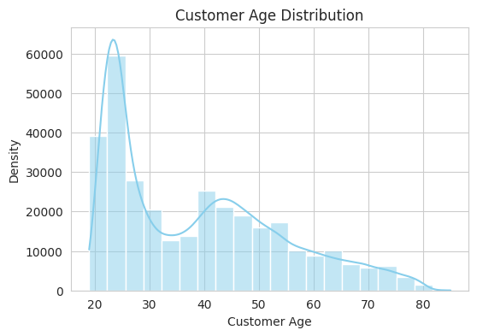

Slide 7
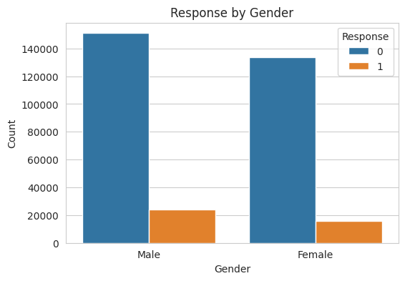

Slide 8
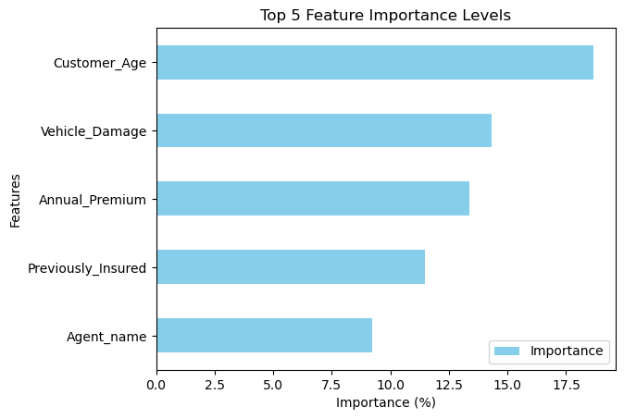
Feature Importance
Whether vehicle has previous damage and whether it has been insured previously are two most important features

Slide 9
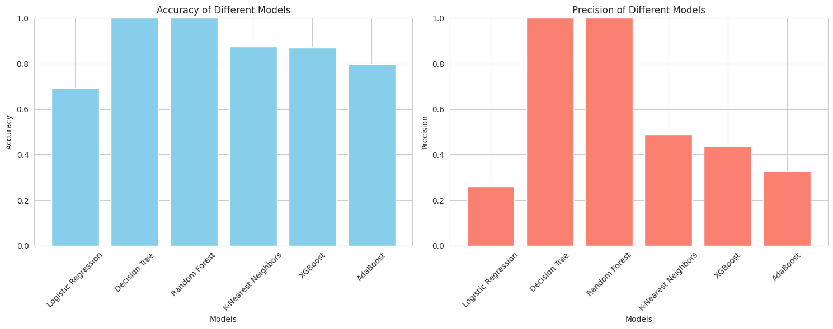
89,56,124$
185,244 users
100%

Slide 10
Findings
Gen X(1965-1980) and Millennials(1981-1996) are more likely to buy motor vehicle policy
Customers with history of accidents/repairs 23% likely to buy motor vehicle policy.
Top Sales Agents with Jomo and Njoroge leading in cross sale conversions way ahead of the rest.
Males are 4% likely to buy policy compared to females
23% of policy holders previously insured are likely to buy motor vehicle policy
We’ve 12% chance of converting a customer with a DL compared to 5% without DL

Slide 11

Conclusion
Random Forest has the highest prediction accuracy and we recommend ICEA Lion Group to use the model for prediction.
The company needs to focus on the history of vehicle damage and the customers' vehicle insurance background to refine its marketing and communication strategies.

Slide 12
Recommendations
Target previously insured customers through policy upgrades & renewal incentives.
Customize marketing messages for customers who have experienced previous vehicle damage, emphasize on comprehensive coverage.
Consider age-specific needs.
Provide customized insurance options based on the age of the vehicle to ensure all customers receive comprehensive protection.
Utilize sales agents for personalized recommendations.

Slide 13
THANKS!
Any questions?

